Slide 1
K. J. Somaiya Institute of Engineering & Information Technology, Mumbai
Department of Computer Engineering
DIGITAL DIARY
Trushil Dhokiya– 24
Aditya Bhavsar – 12
Arya Madan–59
Aniket Kulkarni– 56
Supervisor
Ms. Shubhada Labde

Slide 2

Outline of Project
Introduction
Problem Statement
Software Requirement
Proposed System / Idea
System Design/Diagram(block diagram or flowchart etc)
System Implementation
Results and Conclusion
References

Slide 3
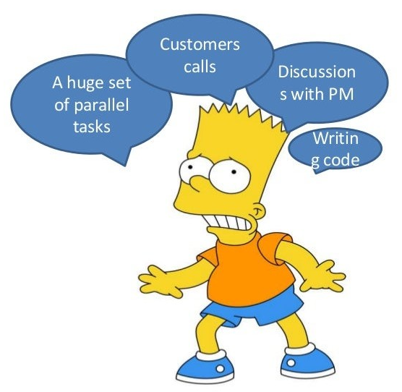
Introduction
Digital Diary :
Our project is a ‘Digital Diary’ or in other words a ‘To-Do List’.
Our project is aiming to schedule the tasks of people so that they can manage it in a organized manner.
We will use Java, Java AWT, Java Swing .

Slide 4

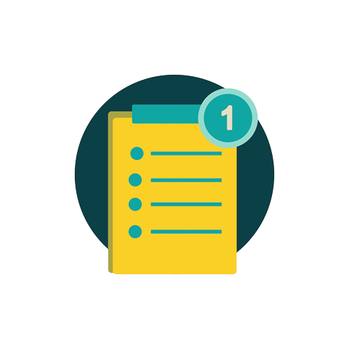
Problem Statement
What can we do with this?
There are many programs for time management which can help us.
We choose To-Do List because it has an extra simple user interface and free open source license.

Slide 5



Software Requirement
JDK 18.0.2.1
IntelliJ IDEA 2022.1
4 Gb RAM
Min. 1.5 Gb of Disk Space
Intel i3 / AMD Ryzen 3 or higher
64-bit Operating System

Slide 6
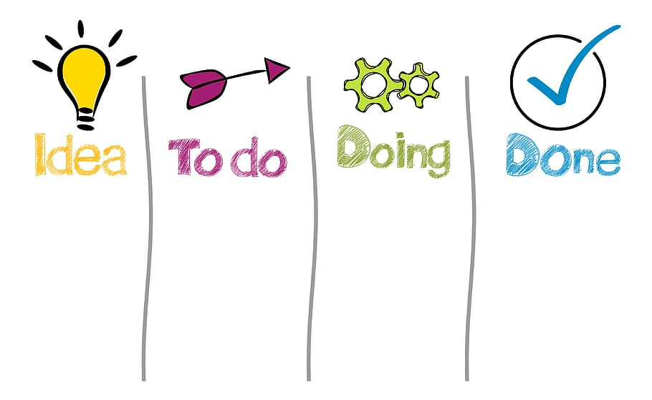


Proposed System / Idea
Adding tasks in an organized and easy manner with the help of icons and images.
Easy deletion and change in appearance of tasks when completed.
Keeping motivated by awarding users with badges.
User friendly UI.
Runs on all desktops and laptops.

Slide 7
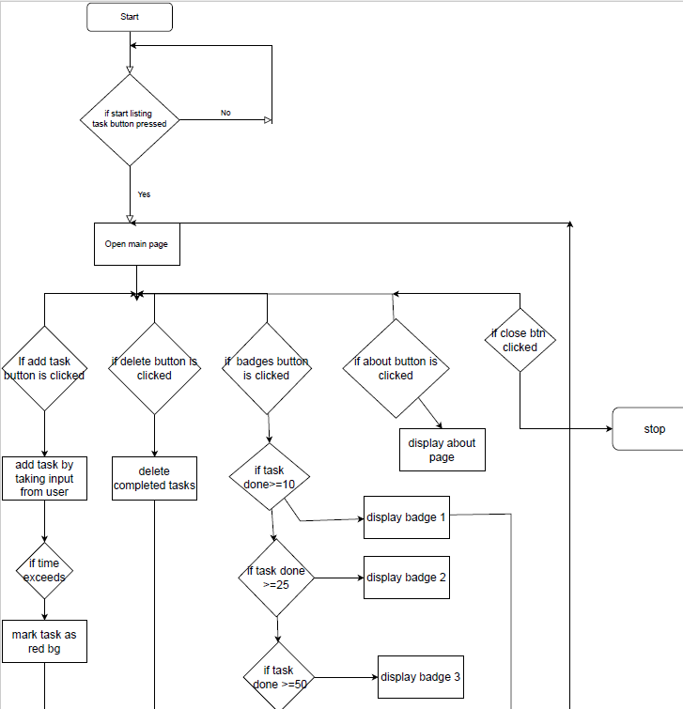
System Flow
Flowchart depicting the flow of execution of the project.

Slide 8
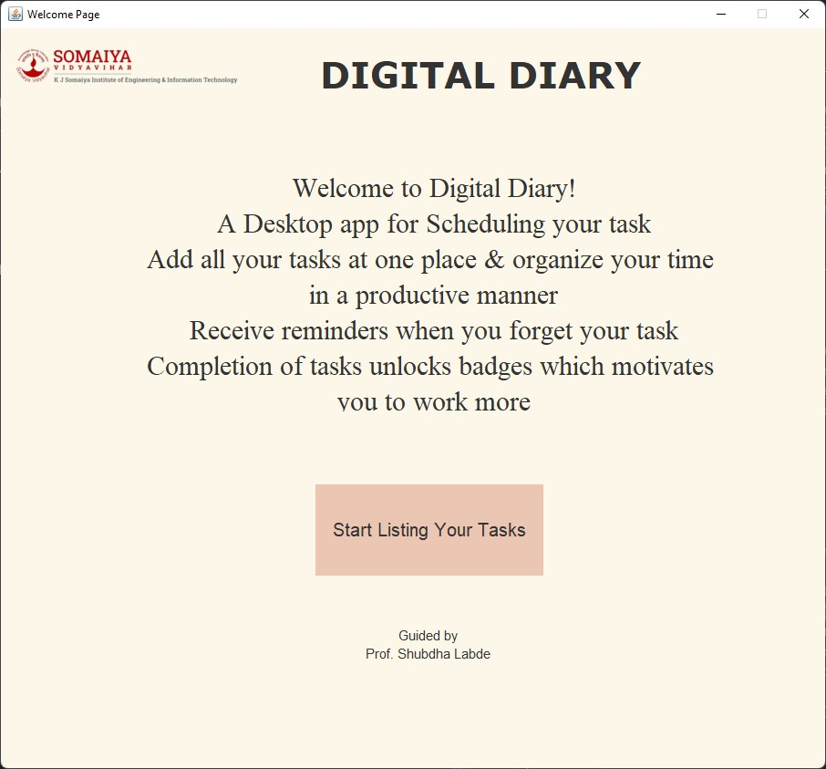
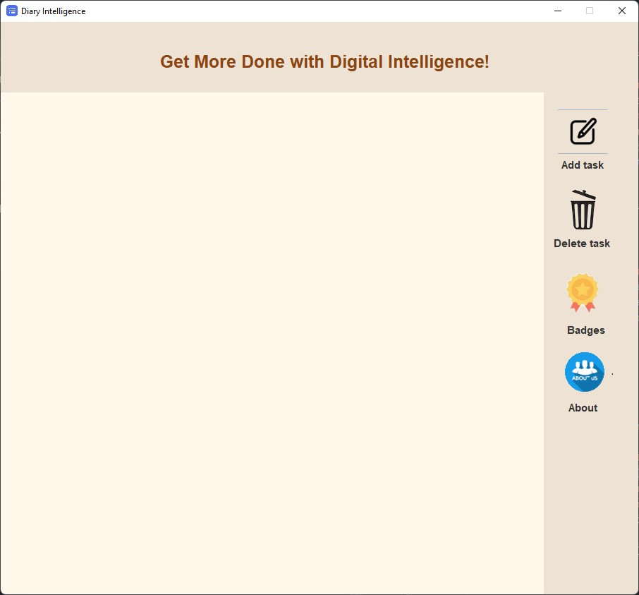
Output of the Prototype:
First Page of Software
Home Page of Software

Slide 9
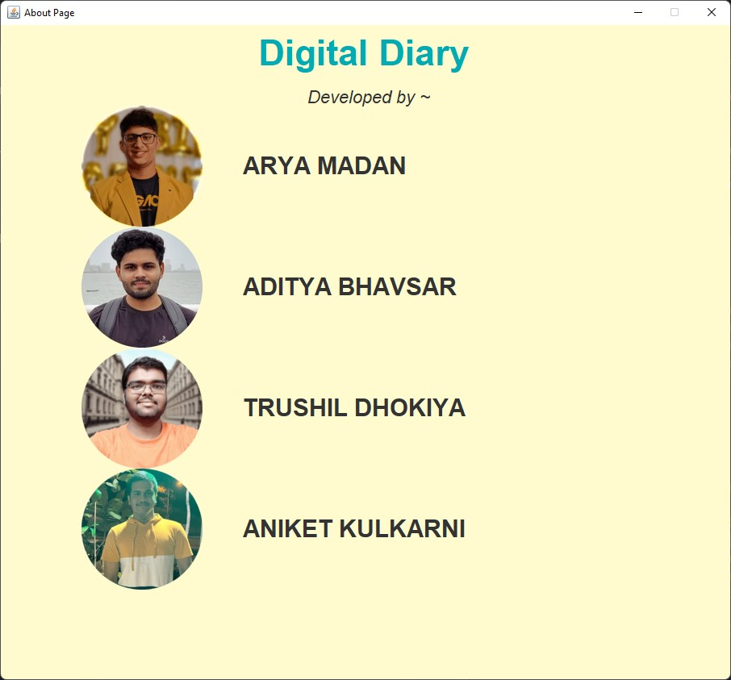
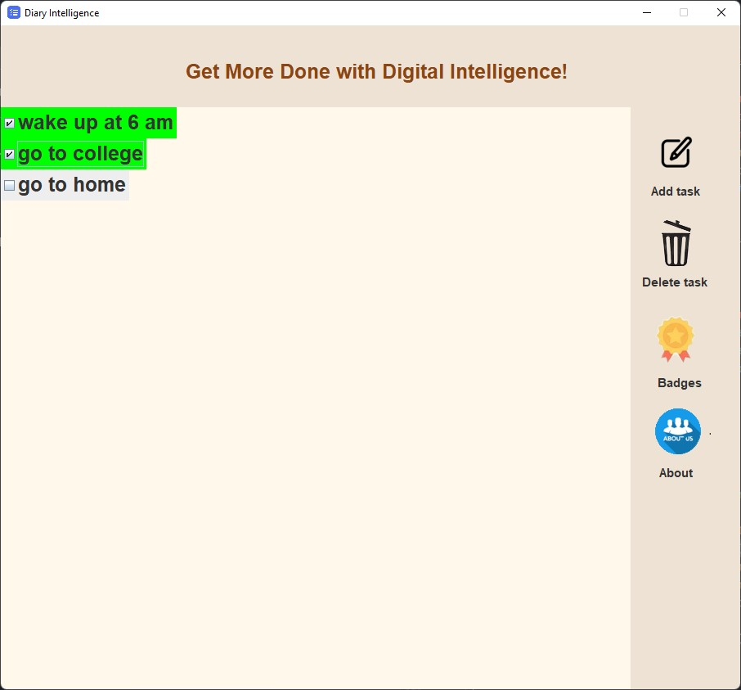
About Page consisting Names of software developers
Addition of Task

Slide 10
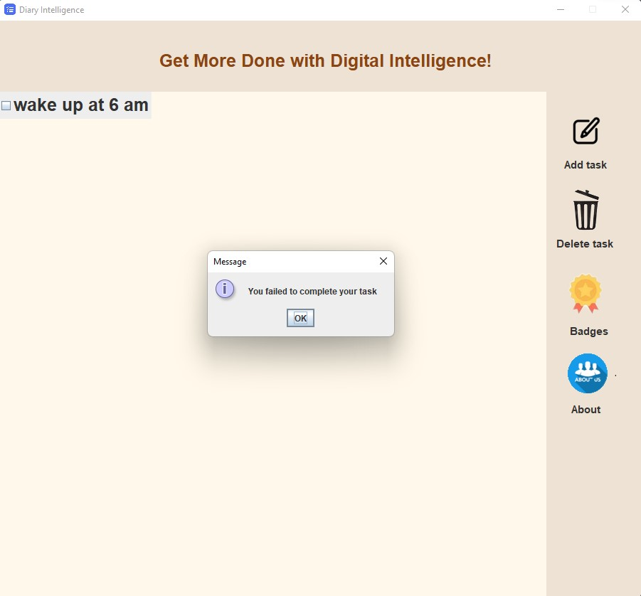
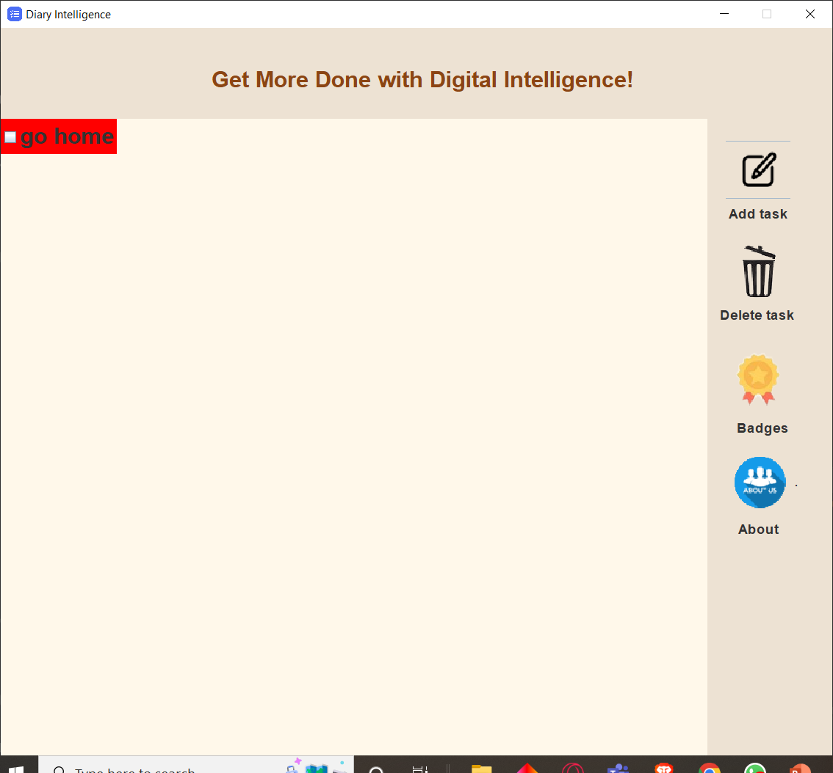
Reminder of Task
Failing to do the task

Slide 11
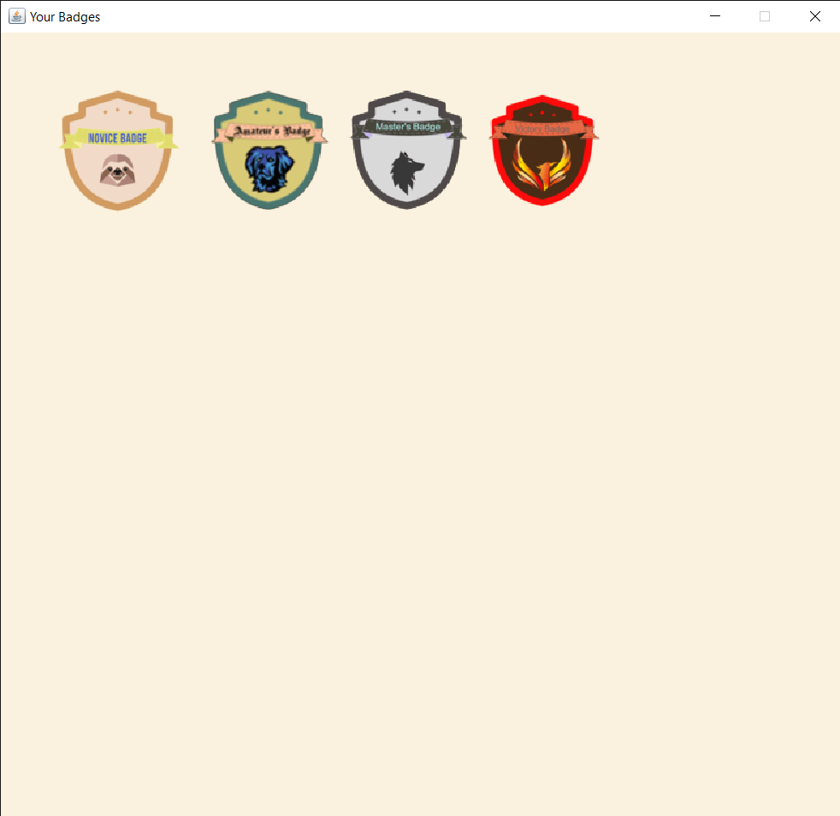
Rewards In Form of Badges

Slide 12

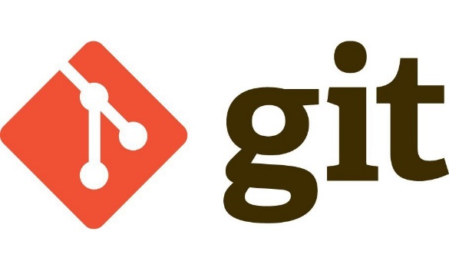
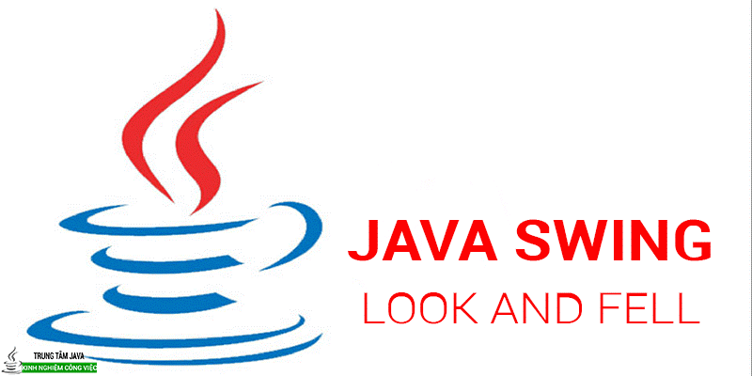
System Implementation
Creation of GitHub Repository.
Installation and Understanding of Git.
Researching on the various softwares which would be needed for implementation stage.
Designing of the project layout and the various features that would be present in the project.
Finally, starting the implementation.

Slide 13

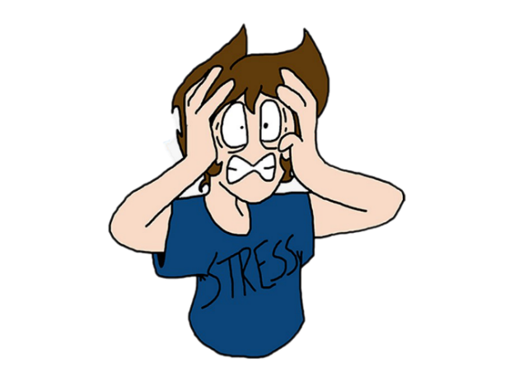

Results
It will let you save time.
It will help you be more reliable.
Keeps you motivated to achieve your goals.
Reduces stress
Increases productivity
Provides an aim to complete your dreams.

Slide 14

Conclusion
Succeeding in today’s work environment is tough. There are too many projects and tasks to manage. With new things popping up and your personal commitments, things can get overwhelming. Add the huge amount of distractions and you’re in for a difficult climb up the ladder of success.
Having a to-do list can make things much easier. Whether you’re looking to achieve more of your goals or controlling your time better, a to-do list will help you. You can get a positive boost to your career by becoming the person who is always on top of things and feel good every day.

Slide 15
REFERENCES
For learning java
https://youtu.be/xk4_1vDrzzohttps://youtu.be/ltX5AtW9v30
For java AWT
https://youtu.be/jvCBSPxFCmk
Git and GitHub
https://progit2.s3.amazonaws.com/ › ...PDFPreface by Scott Chacon - Pro Git
https://youtu.be/gwWKnnCMQ5c

